Slide 1

Multimedia Hanjar
(Visual Medium)

Slide 2
Overview
This application contains a variety of teaching materials presented in interactive and interesting multimedia formats (audio, video, text). The material is arranged according to the systematics of the original manuscript and is supported by relevant visualizations and narrations to further strengthen the understanding of the material.

Slide 3
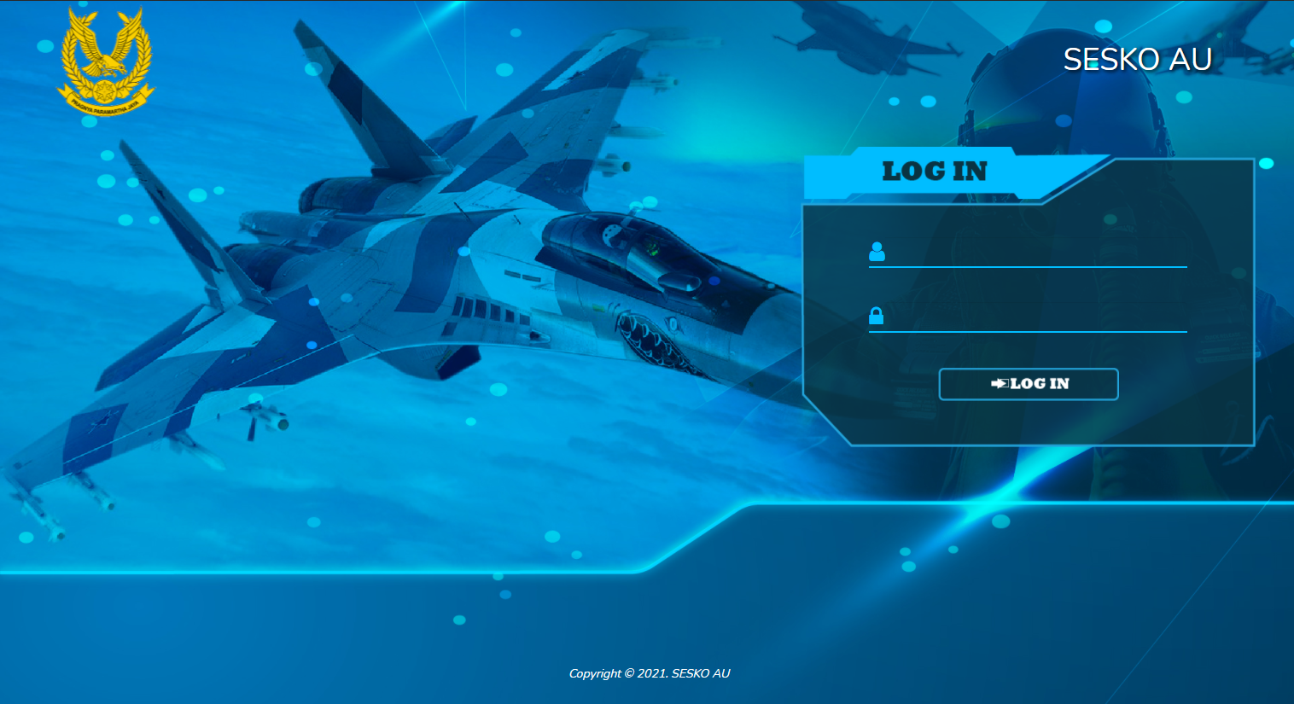
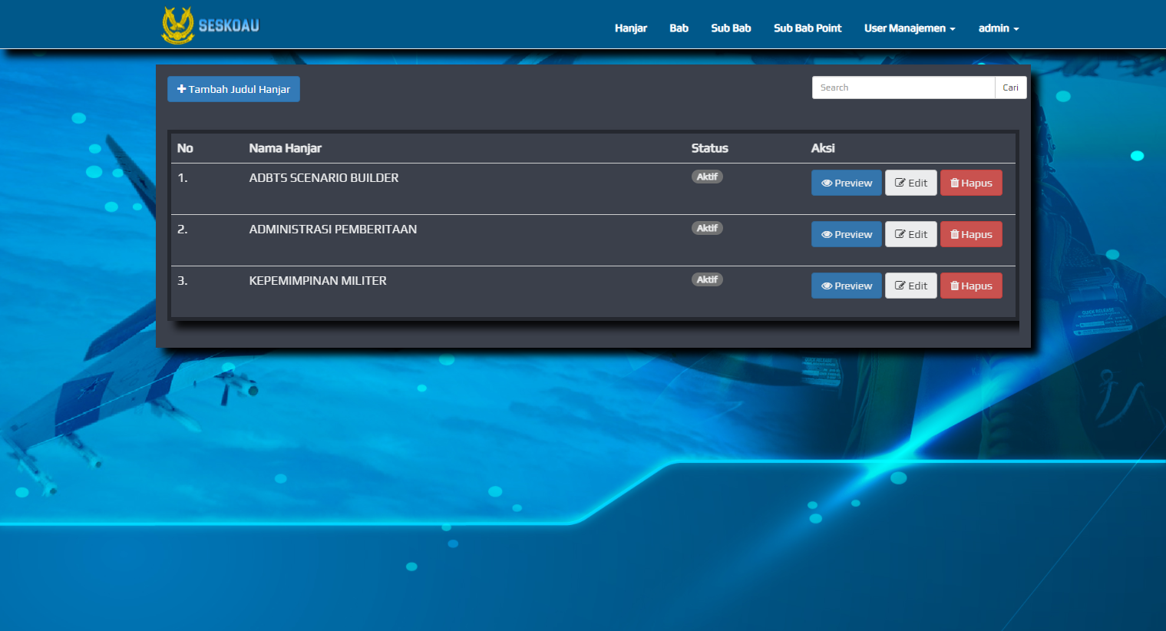
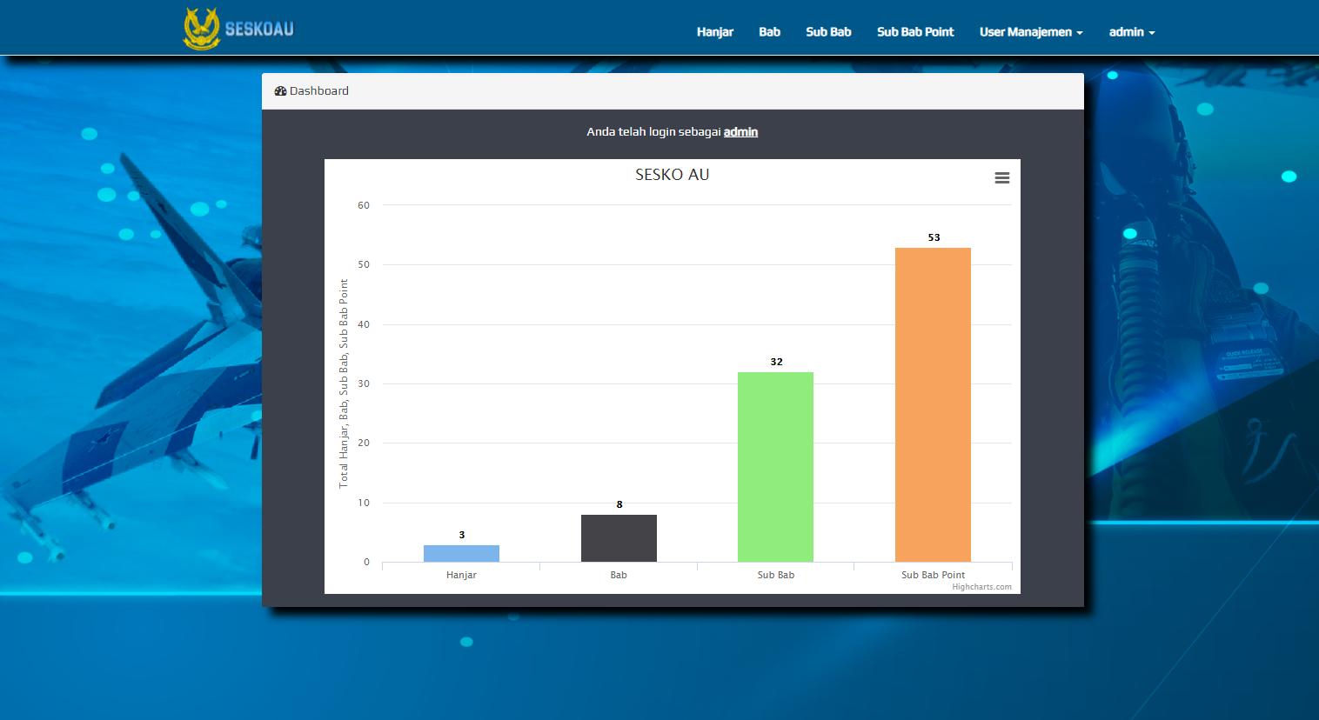
Features / Functions
This application is a web-based application that has several features such as:
Displays a list of study materials
Adding a list of study materials
Displaying learning materials in the form of animation/multimedia
Displaying the amount of learning material in graphic form

Slide 4
THANKYOU

